Slide 1
POLITICAL DEVELOPMENT OF MUSLIMS
In modern era

Slide 2
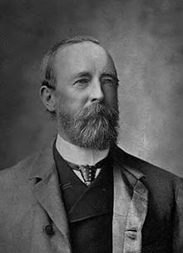
INDIAN NATIONAL CONGRESS
1885
Founder Allan Octavian Hume 1885
A.O Hume was a retired British ICS officer.
Main objectives of Congress
Submerge the entire population
Develop moral, social and political status.
To establish good relations between England and India.

Slide 3
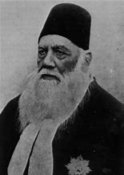
INDIAN COUNCIL ACT 1892
Due to Hindu dominancy in congress, Congress started neglecting Muslims.
Hindus demanded General Elections regarding Central and Legislative seats.
Sir Syed opposed this demand and emphasized on act of 1861.
Results of Sir Syed’s Opposition
Number of non-official members increased.
Members were allowed to discuss the budget.
Elected members were able to go to legislative councils.

Slide 4
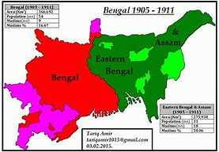
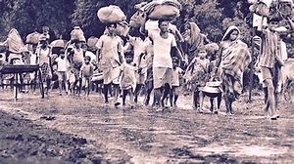
PARTITION OF BENGAL
16 October 1905 by Lord Curzon
Pre- Partition Difficulties
Difficulty in building districts on concentrated area of (189,000)Sq
miles. Bengal, Bihar and Orissa etc.
Population before Partition was approximately 78.5 million by 1903.
Post-Partition
The population of West Bengal was 54 million in which ( 42m Hindus, 9m Muslims).
The population of East Bengal 30 million in which (12mHindus, 18m Muslims). They appeared easy to manage.

Slide 5
EFFECTS ON MUSLIMS DUE TO
BENGAL PARTITION.
Muslims experienced development due to majority in terms of politics, economics and education.
While Hindus opposed the Partition and declared this decision of British as “Divide and rule Policy”.
ANNULMENT OF PARTITION
British annulled Bengal in 1911 to please Hindus.

Slide 6
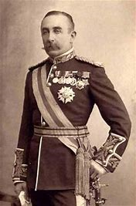
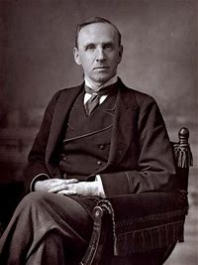
SIMLA DEPUTATION 1906
Probably the first step towards creation of Pakistan.
1st October 1906, 35 Muslim leaders meet with Lord Minto. Led by Agha Khan.
DEMANDS IN SIMLA DEPUTATION 1906
Employment of Muslims
Representation in universities.
Separate Election and weightage.
Imperial Legislative Council.
A Muslim University.
Lord Minto supported separate demands and this became the basis of Minto-Morley Reforms.

Slide 7
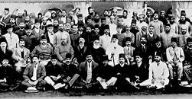
ALL INDIA MUSLIM LEAGUE
Founded on 13th December 1906.
Annual Session of Muslim Education Conference took place in Dhaka.
Chairman Nawab Viqar-ul-Mulk.
Nawab Salimullah Khan presented before 3000 people a demand for separate platform for Muslims. (known as Muslim league)
First President, Sir Agha Khan.
Headquarter In Lucknow.
MAIN OBJECTIVE
To safeguard rights and interests of Muslims.
To support their demand for separate electorates and representatives.
To make major steps towards the creation of Muslim state.

Slide 8
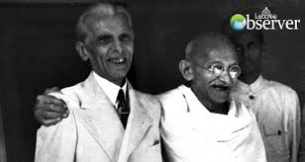
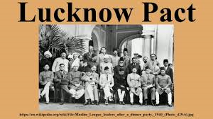
LUCKNOW PACT
This Pact was made on December (1916) in Lucknow.
Muslim League and Congress both took active part.
SALIENT FEATURES:
Separate Electorates were accepted.
Muslims were granted 1/3 of the seats in Central Assembly.
Autonomy Should be granted to all provinces.
Every Constitution was to be accepted on approval of ¾ of nationality.

Slide 9
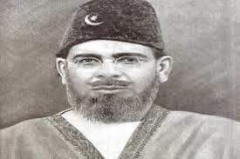
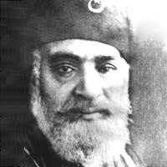
KHILAFAT MOVEMENT
This Movement was started on 17th Oct. 1919.
Led by Moulana Muhammad Ali Johar and Moulana Shoakat Ali Johar.
Main Objectives
Protection of the Holy Places of Muslims.
To Maintain the Turkish Caliphate.
To maintain the Unity of the Ottoman Empire.
Non-Cooperative Movement.
Hijrat.
Chori Chaura Incident.

Slide 10
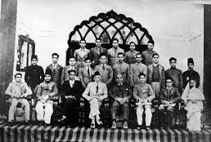
DELHI PROPOSAL
Quaid-e-Azam called a conference of Muslim Leaders in Delhi in 1927.
For the discussion of future Constitutional Reforms.
DEMANDS:
Separation of Sindh from Bombay.
One Third representation of Muslims in Central Legislative Assembly.
Introduction of Reforms in N.W.F.P and Balouchistan.

Slide 11
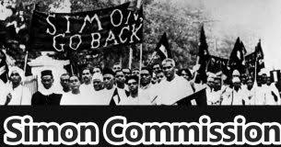
Simon Commission
A Commission of Seven members was made by Lord Irwin, the Viceroy of India in 1927.
The Chairman of the Commission was Sir John Simon.
Hindu leaders Boycotted the commission before its arrival in Bombay on15th February.
SALIENT FEATURES:
The Diarchy system should be abolished.
Introduction of Federal system of Government.
Creation of an expert Committee Regarding the “Separation of Sindh”.

Slide 12
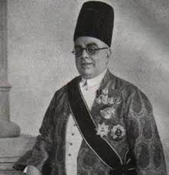
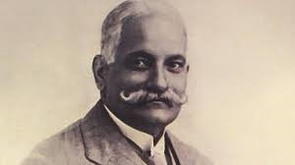
NEHRU REPORT
This report was presented on 28 august 1928 by Moti Lal Nehru
Key points of NEHRU REPORT.
Nehru report was a memorandum for new constitution of Joint India.
Nehru Report supported Federation of joint India.
It Stated that Governor General would be from India.
DEMANDS OF SIR AGHA KHAN AFTER NEHRU’S FAVOARTISM
Muslims will also elect their representatives.
Muslims will have their due share in central and provincial Cabinets.

Slide 13
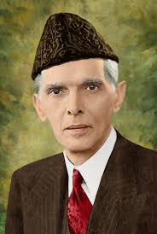
JINNAH’S FOURTEEN POINTS
Quaid-e-Azam Muhammad Ali Jinnah Presented his 14 Points
As the Constitutional Reforms for the Safeguard of political
rights of Muslims in 1929.
Few Summarized Points:
Federal constitution power in provinces.
Muslim representatives in central legislative.
Separate Electorates.
Representation of minorities.
Right of Muslims to elect their representatives.
Religion liberty to all Communities.

Slide 14
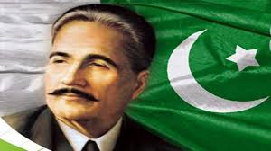
ALLAMA IQBAL’S ALLAHABAD ADDRESS
Allama Muhammad Iqbal Addressed on 29 December 1930.
He demanded for separate homeland for Indian Muslims due to following reasons:
Differences of Religions.
Performances of Rituals and Prayers.
Occasions and Creeds of different kinds.
And he declared that neither British nor the Hindu rules can be applied on Muslims of India.

Slide 15
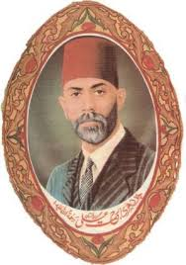
CHAUDRY REHMAT ALI
He was born in 1895 in a district of Punjab.
He got his early education from Lahore,
He had a thought in mind for a separate state for Muslims.
He established “PAKISTAN NATIONAL MOVEMENT”
He issued a pamphlet “NOW OR NEVER, ARE WE TO LIVE or PERISH FOREVER”.
The name PAKISTAN was coined by him.

Slide 16
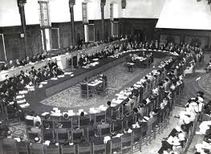
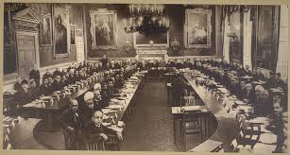
ROUND TABLE CONFERENCE 1930-32
This conference was called for the purpose of discussing the future constitutional matters.
1st Round Table Conference:
Began in London on 12th Nov 1930.
All Parties participated except congress due to civil disobedience of ghandi.
Muslim Representatives: Sir Agha Khan, Muhammad Ali Johar, Quaid e Azam, Fazal ul Haq and few others.
Salient Features:
Sindh was made separate Province.
A fully responsible government in the province.
SECOND RTC (In London, on 7th Sep, 1931)
THIRD RTC (In London, on 17th Nov, 1932)

Slide 17
GOVT. OF INDIA ACT 1935.
This was a bill passed by the British in Feb., 1935.
Indian provinces were given autonomy for the 1st time.
This act was enforced in 1937.
Elections of 1937:
Act of 1935 didn’t satisfy both parties (Congress and Muslim League)
British decided to hold election.
Both Parties agreed and Election was held in 1937.
Due to disappointment from both parties Quaid-e-Azam left politics and went England.
Quaid-e-Azam came back after three years.
Muslim league lost against Congress in elections, in 11 provinces.

Slide 18
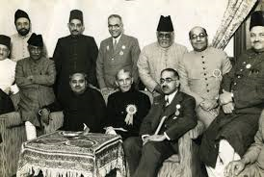
CONGRESS MINISTRIES.
Deeds of Congress (1937-39):
They ruled badly/ worst at all.
It became the period of political corruption & high handedness.
Mandirs were introduced to infuse Indian nationalism among children.
Muslim students were given no opportunity.
Pre-planned Conspiracy was made to destroy Muslim identity.
Days of WW2
DAY OF DELIVERENCE
Congress continued its un-human and unlawful atrocities on the Muslims.
They deprived them from their legal, political and social rights & interests.
As the 2nd world war broke, the congress resigned.
On that occasion Muslims expressed their joy and celebrated.
“THE DAY OF DELIVERENCE”.

Slide 19

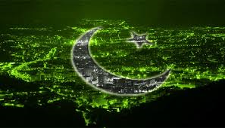
REORGANIZATION OF MUSLIM LEAGUE
Muslims got defeated in the elections of 1937 and were treated like minority.
Jinnah was aware from the conditions of Muslims and Muslim League.
In 1933 “NOW OR NEVER” pamphlet by Ch, Rehmat Ali, expressed the concept of separate homeland for Muslims.
It was a difficult task to reorganize such a party but after struggling, finally in March 1934, after the meeting of all prominent leaders of Muslims.
"THE MUSLIM LEAGUE” was reorganized and Muhammad Ali Jinnah was made President.
It was all Jinnah’s efforts in making steps towards the creation of the term which was coined Rehmat Ali known as PAKISTAN.

Slide 20
THANK YOU!

